Slide 1


Employee Attrition Prediction
Sashidhar Bezawada

Slide 2
Agenda
Introduction
Dataset & Source
Data Transformation
Exploratory Data Analysis
Risks / Contingencies
Models & Metrics
Result Interpretation
Conclusion
References

Slide 3


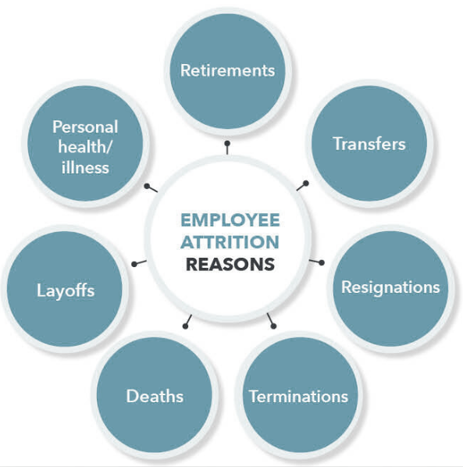
Introduction
Definition : “When an employee leaves the company through any method, including voluntary resignations, layoffs, failure to return from a leave of absence, or even illness or death”
Two types of employee attrition:
Voluntary
Employee deliberately chooses to leave their company -illness, personal reasons like compensation, work-life balance, burnout due to overtime & overwork, etc.
Involuntary
The company chooses to let go of an employee
Reorganization layoffs - In this case, the company either eliminates the employee’s position altogether or chooses not to replace it

Slide 4
As a current employee at a company, I have started to take note of what motivates and what deters other employees. Many things play into people’s decisions to leave a company, and it is intriguing to me to understand what causes movement in the workplace and also how companies can ideally increase their employee retention at the end of the day.
Statistical Question:
What factors play a significant role in predicting voluntary employee attrition?

Slide 5
Dataset & Source
Synthetically generated IBM dataset that contains employee attrition data.
Gathered information around employee satisfaction, income, job level and some personal demographic data such as age , gender and distance from home
Dataset structure:
1470 rows of data
35 columns
Each record in the dataset pertains to an employee that is either currently at IBM or voluntarily left
Attrition = ‘Yes’ or ‘No’
https://www.kaggle.com/pavansubhasht/ibm-hr-analytics-attrition-dataset

Slide 6
Data Transformation
I have performed the NULL value inspection and duplicate checks, found none.
I have also performed Variable Inspection and performed labelling of categories in Numerical Features for the below attributes.
df_attrition["BusinessTravel"] = df_attrition["BusinessTravel"].replace({1:"Non-Travel", 2:"Travel_Rarely", 3:"Travel_Frequently"})
df_attrition["Education"] = df_attrition["Education"].replace({1:"Below College",2:"College",3:"Bachelor",4:"Master",5:"Doctor"})
df_attrition["JobInvolvement"] = df_attrition["JobInvolvement"].replace({1:"Low",2:"Medium",3:"High",4:"Very High"})
df_attrition["JobLevel"] = df_attrition["JobLevel"].replace({1:"Entry Level",2:"Junior Level",3:"Mid Level",4:"Senior Level",5:"Executive Level"})
df_attrition["JobSatisfaction"] = df_attrition["JobSatisfaction"].replace({1:"Low",2:"Medium",3:"High",4:"Very High"})
df_attrition["PerformanceRating"] = df_attrition["PerformanceRating"].replace({1:"Low",2:"Good",3:"Excellent",4:"Outstanding"})
df_attrition["RelationshipSatisfaction"] = df_attrition["RelationshipSatisfaction"].replace({1:"Low",2:"Medium",3:"High",4:"Very High"})
df_attrition["WorkLifeBalance"] = df_attrition["WorkLifeBalance"].replace({1:"Bad",2:"Good",3:"Better",4:"Best"})

Slide 7
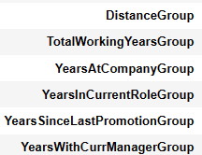
Data Transformation(Cont…)
Binning (New Variables created) :

Slide 8
Exploratory Data Analysis

Slide 9
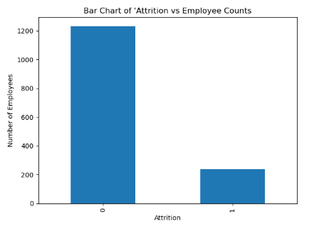
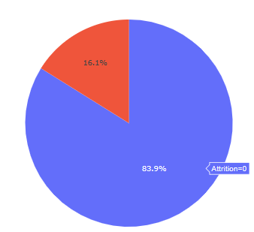
Data Visualizations
Bar Chart of Attrition :
Replacing "Yes" and "No" in target variable with 1 and 0
Imbalance between the two classes of 0 & 1
‘0’: 1,233 values
‘1’: 237 values

Slide 10
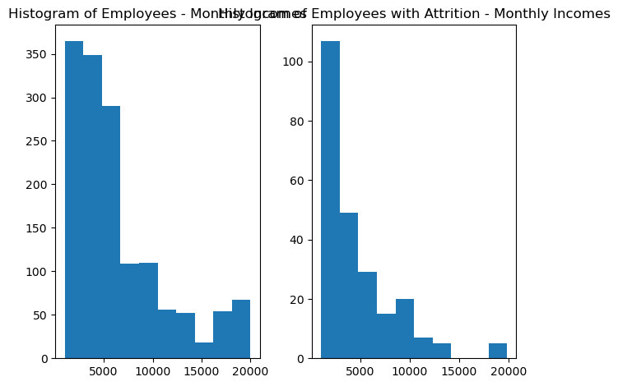
Data Visualizations
Histogram of Employees – Monthly Incomes & Attrition

Slide 11
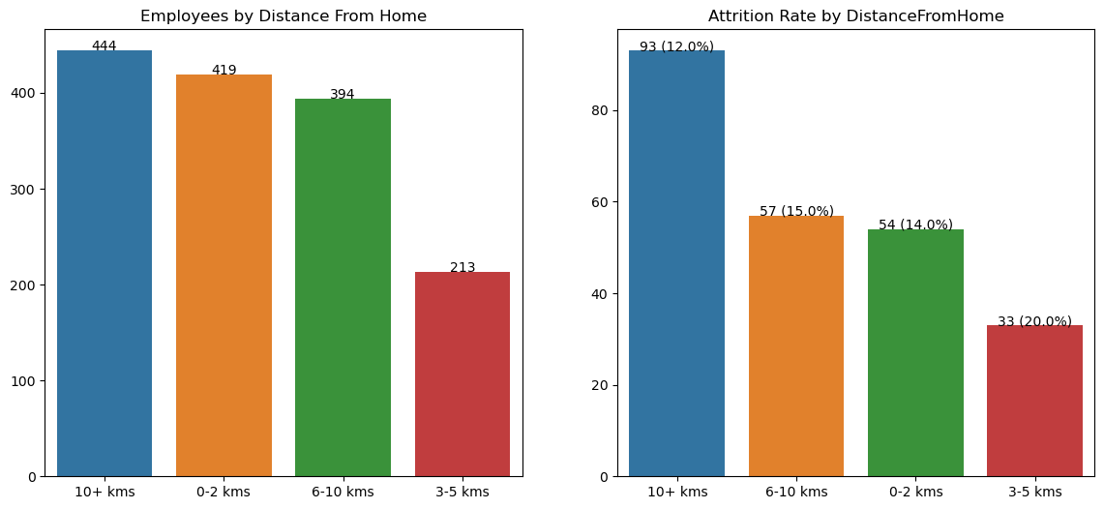
Data Visualizations
Histogram of Employees by Distance From Home & Attrition :

Slide 12
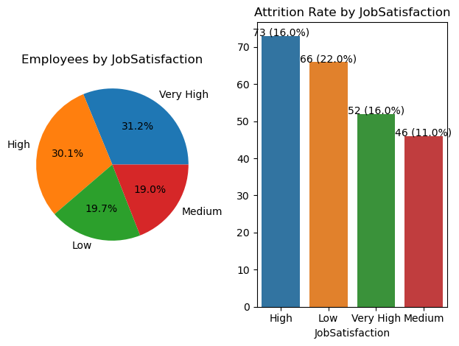
Data Visualizations
Employees by JobSatisfaction & with Attrition :

Slide 13
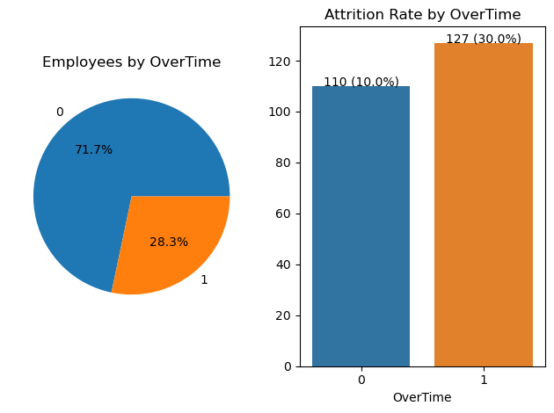
Data Visualizations
Employees by OverTime & with Attrition :

Slide 14
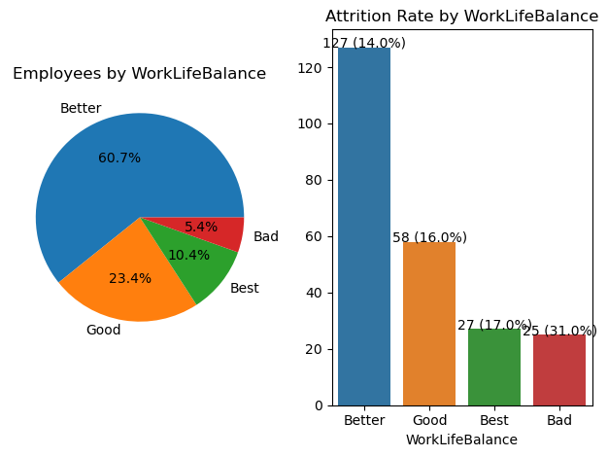
Data Visualizations
Employees by WorkLifeBalance & with Attrition :

Slide 15
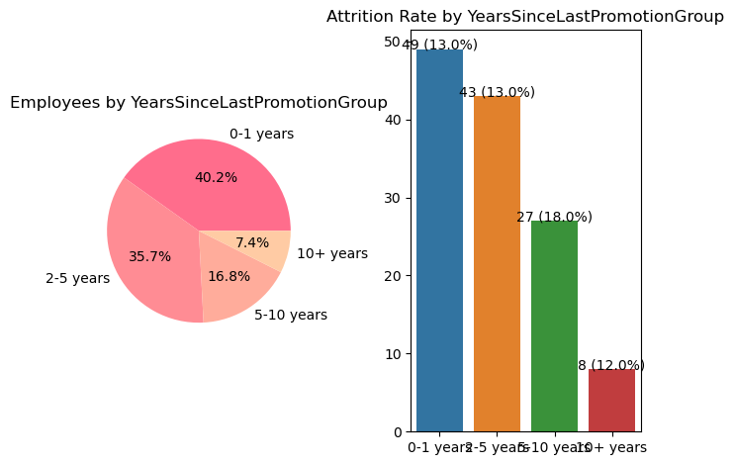
Data Visualizations
Employees by YearsSinceLastPromotion & with Attrition :

Slide 16
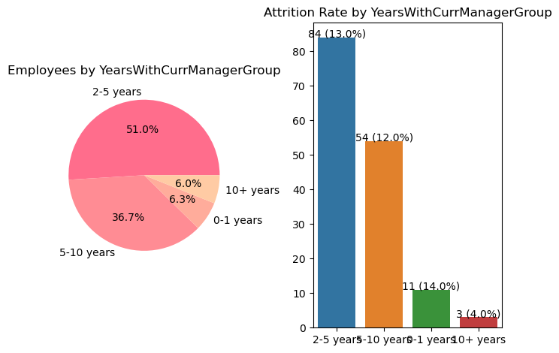
Data Visualizations
Employees by YearsWithCurrManager & with Attrition :

Slide 17
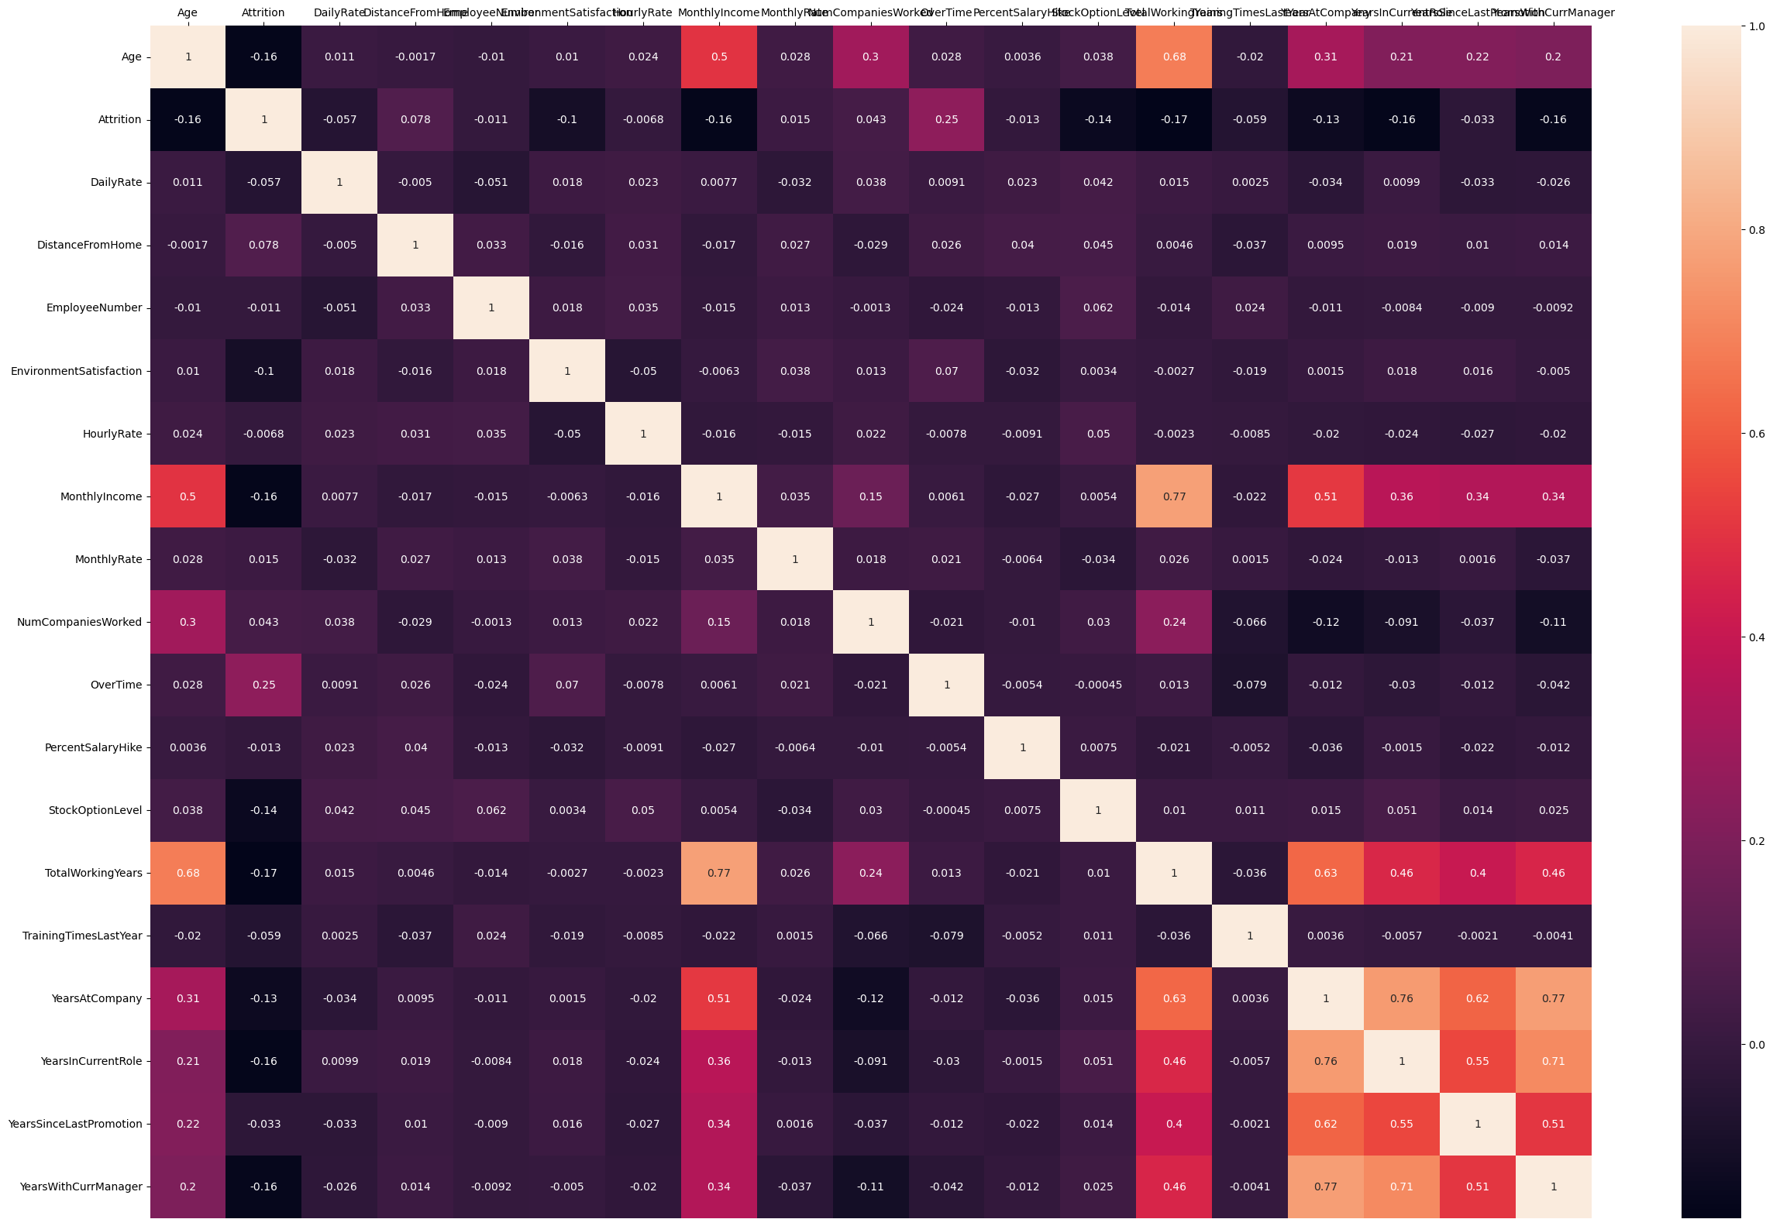
Exploratory Data Analysis (Cont…)
Heat maps to identify the correlation :
From the correlation plots, most of the columns seem to be poorly correlated with one another. Generally, when making a predictive model, it would be preferable to train a model with features that are not too correlated with one another so that we do not need to deal with redundant features.

Slide 18
Risks / Contingencies
Since the dataset is small and simulated, it is highly possible that few models may perform poorly on the data hence as a contingency plan, I have aimed to apply multiple models and compare the results but still results may not be aligned with real world scenario, but I take this opportunity in validating my understanding with end-to-end flow of applying predictive analytics to a problem.
In general, such datasets would be imbalanced ,So, I have used SMOTE, to generate new and synthetic data, which can be used for training our model.

Slide 19
Models & Metrics

Slide 20
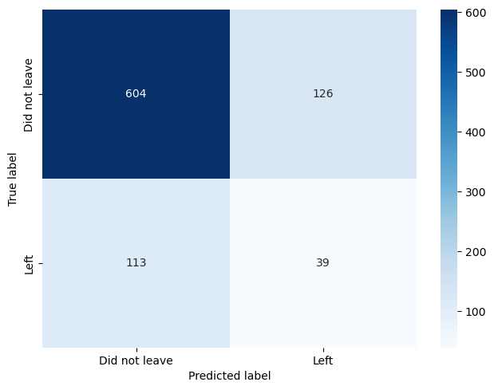
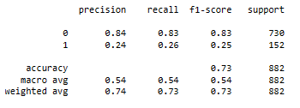
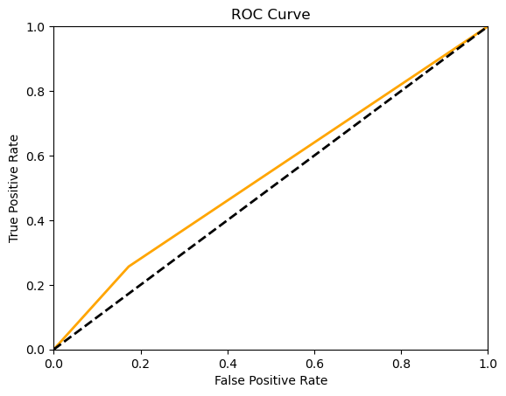
K-Nearest Neighbor
Accuracy score is good, but has the lowest F1 & Recall scores. The False positive & False negative cases are higher than all models

Slide 21
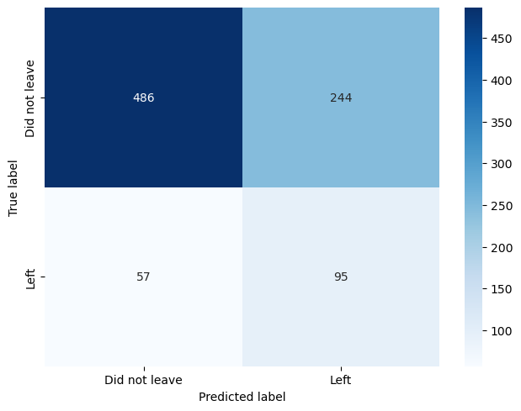
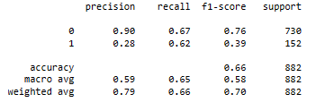
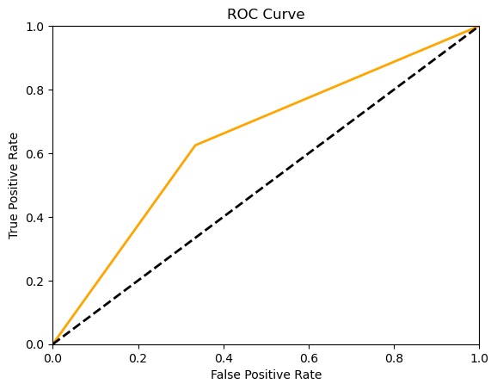
Naive Bayes
Model accuracy is the lowest among the 6 Models.

Slide 22
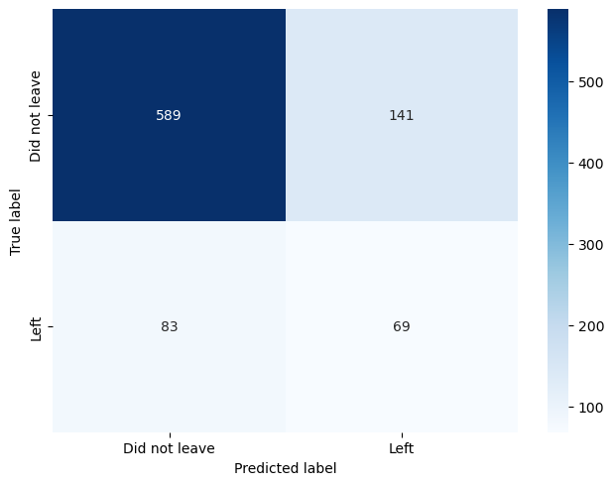
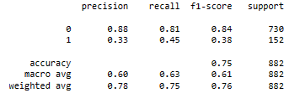
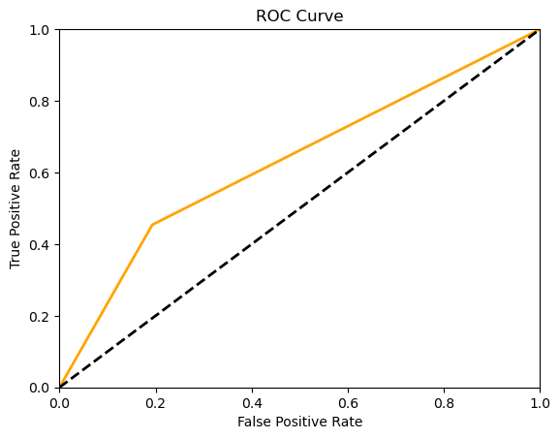
Random Forest Classifier
Accuracy score is good, However the model is not predicting the Attrition correctly (precision is low) and it identifies False negatives better than all ( Recall Score is high).

Slide 23

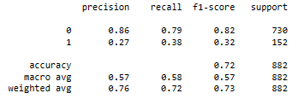
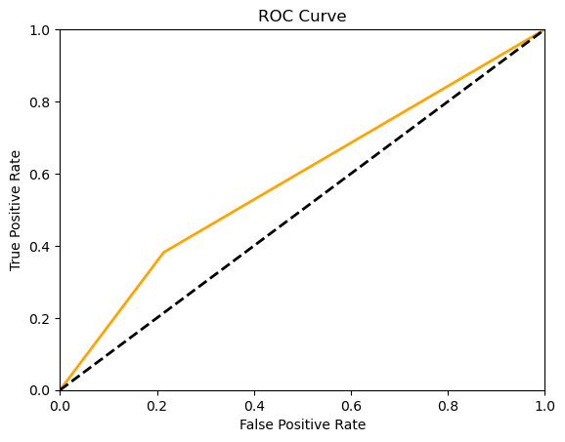
Decision Tree Classifier
Accuracy score is low, however the model is not predicting the Attrition correctly (precision is low)

Slide 24
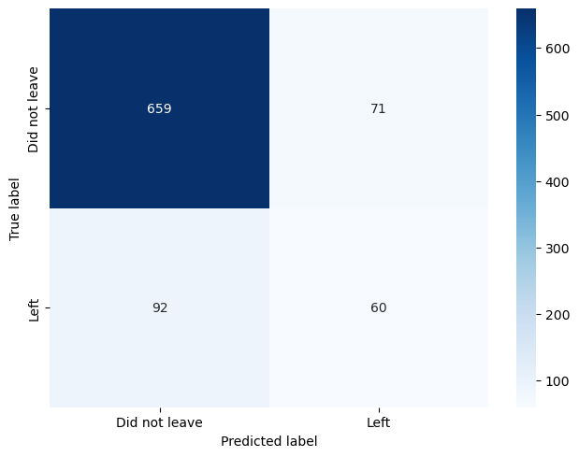
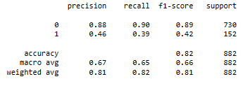
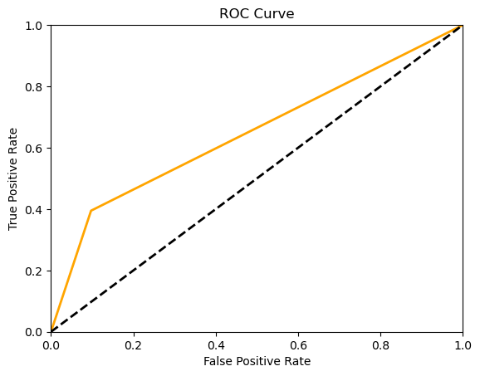
XGBoost Model
Accuracy is high as well as it is identifying the Attrition better. Also, it has high Recall & F1 Scores.

Slide 25

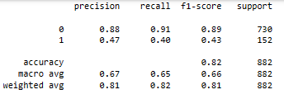

Gradient Boosted Classifier
Accuracy is highest of all . And it is identifying the Attrition with the highest Precision Score.
It also has the highest Recall, F1 & AUC Scores.

Slide 26
Result Interpretation
& Conclusion

Slide 27
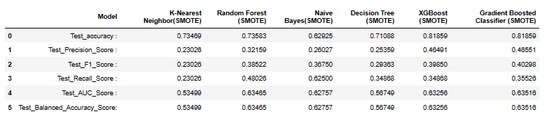
Result Interpretation
SMOTE uses a nearest neighbors algorithm to generate new and synthetic data we used for training our model.
Naive Bayes - Model accuracy is the lowest among the 6 Models.
K-Nearest Neighbor - Has good Accuracy Score, but has the lowest F1 & Recall scores. The False positive & False negative cases are higher than all models.
Random Forest - Accuracy score is good, however the model is not predicting the Attrition correctly (precision is low) and it identifies False negatives better than all ( Recall Score is high).
Decision Tree - Accuracy score is low, however the model is not predicting the Attrition correctly (precision is low)
XGBoost - Accuracy is high as well as it is identifying the Attrition better. Also, it has high Recall & F1 Scores.
Gradient Boosted Classifier - Accuracy is highest of all . And it is identifying the Attrition with the highest Precision Score.It also has the highest Recall, F1 & AUC Scores.

Slide 28
Conclusion
The dataset for this project conveyed that there are many features that factor into an employee’s decision to leave their job; two of the important ones being job satisfaction level and income
The Gradient Boosted Classifier model had the strongest performance with 81.86% accuracy; it also had the second-highest recall score for the ‘No’ class of Attrition at 35.52%. For the ‘Yes’ class of Attrition, it also had the highest precision score of 46.55% which was relatively higher than the scoring of the other models.
The results from these predictions could help organizations save money on staff replacement and productivity loss, and also hopefully decrease turnover rates.
In the current model, feature reduction is not explored to it’s full extent. And that can be considered to make this model better.

Slide 29
Ethical Considerations
Legal compliance: This dataset is a fictional dataset from Kaggle and doesn’t have any legal issue.
Employee Privacy: This dataset doesn’t contain any PII-related information (Personal Identifiable Information ).This data research is not going to harm any privacy.
Unfair practices: The biggest ethical challenge is how the Organization is going to use the Attrition model and not treat employees unfairly based on some factors that contribute to attrition like - age ,salary, etc

Slide 30
References
1.” Five Hidden Costs Of Employee Attrition” - Written by Lisa Wallace
https://www.forbes.com/sites/forbeseq/2023/03/21/five-hidden-costs-of-employee-attrition/?sh=391d2a0c62f4
2. “A STUDY ON EMPLOYEE ATTRITION AND RETENTION WITH REFERENCE TO EVRON IMPEX” by Dr. B. Merceline Anitha , https://www.researchgate.net/publication/370471266_A_STUDY_ON_EMPLOYEE_ATTRITION_AND_RETENTION_WITH_REFERENCE_TO_EVRON_IMPEX
3. https://www.mckinsey.com/featured-insights/sustainable-inclusive-growth/chart-of-the-day/the-great-attrition-stems-from-a-great-disconnect
4. “Employee Attrition: Meaning, Impact & Attrition Rate Calculation” Written by Suzanne Lucas,
https://www.aihr.com/blog/employee-attrition/
https://atlanticpayroll.us/business-basics/employee-attrition-vs-employee-turnover/
https://hbr.org/1973/07/why-employees-stay

Slide 31
THANK YOU

